Slide 1
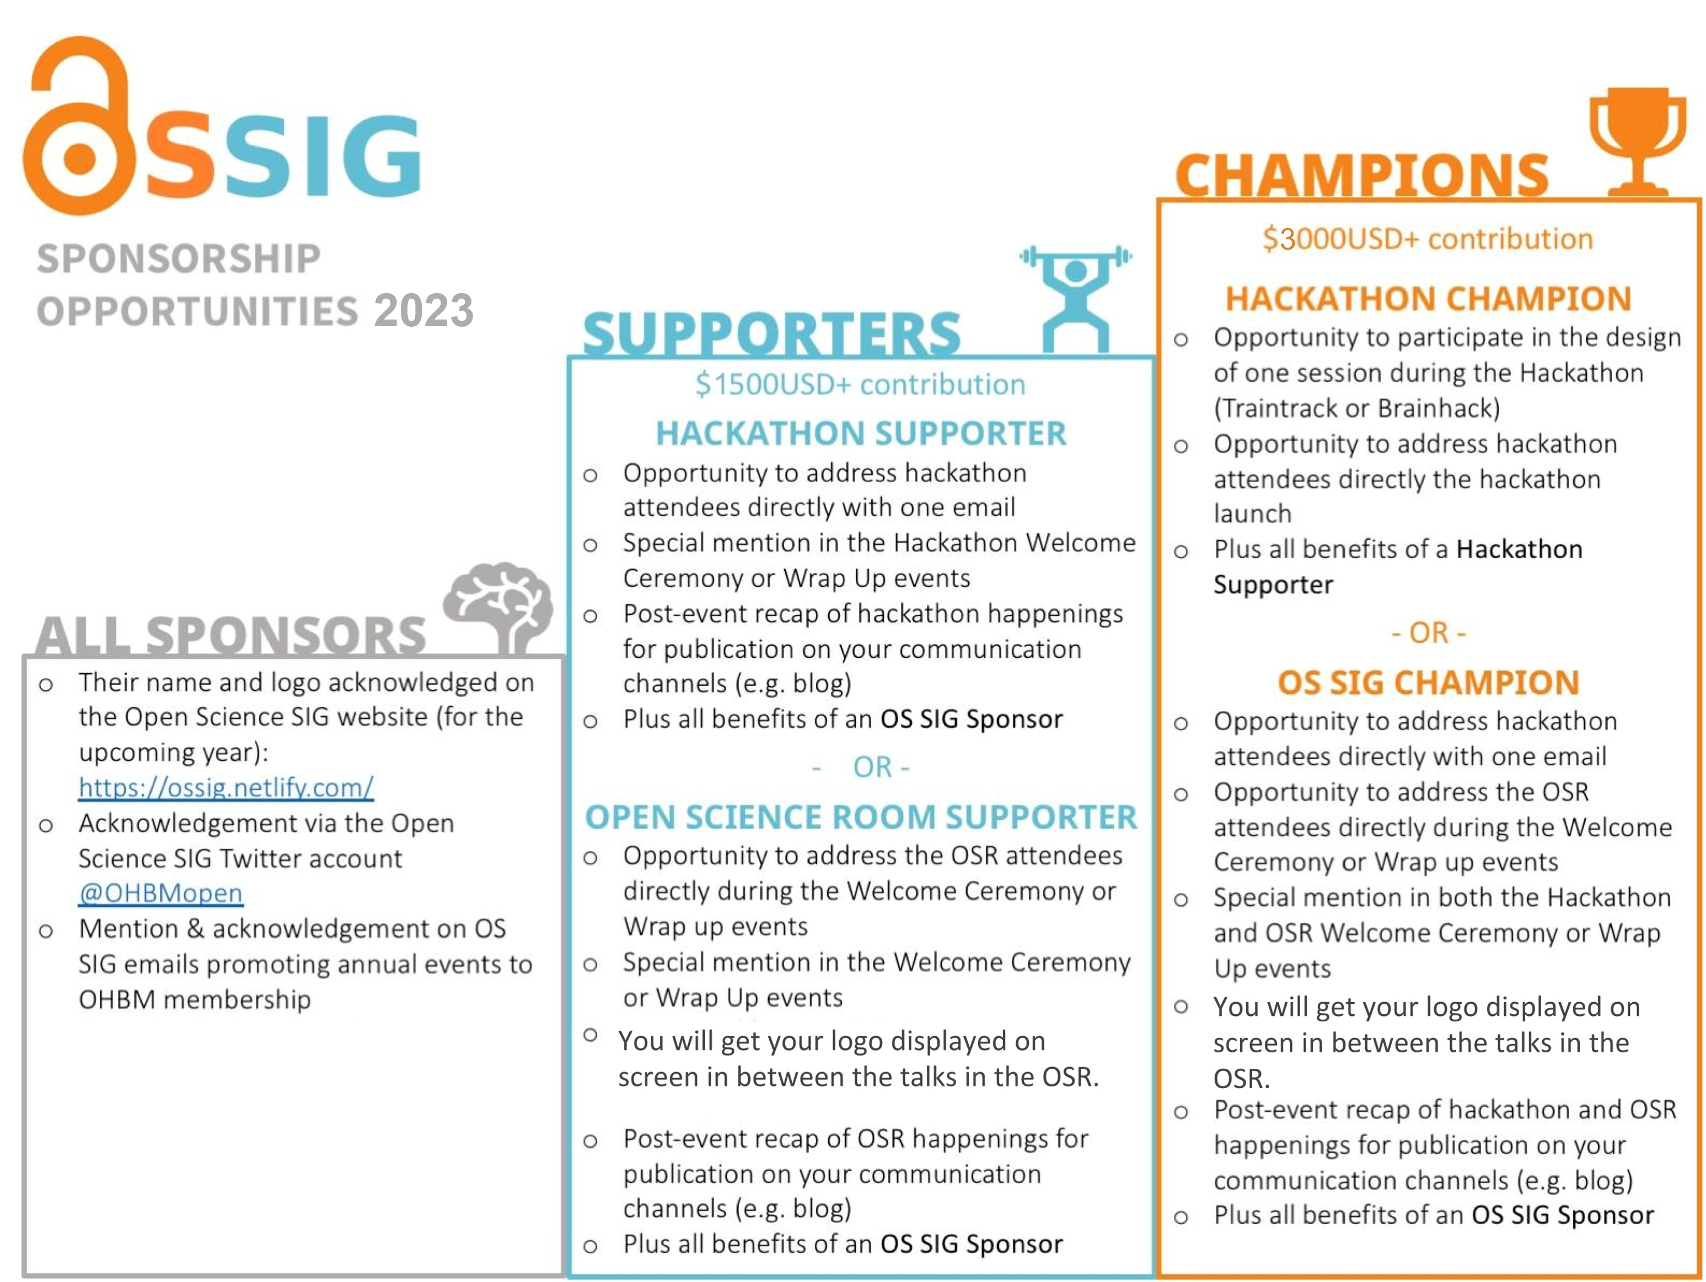
$3000 USD+ contribution
HACKATHON CHAMPION
Opportunity to participate in the design of one session during the Hackathon
Special mention during the Hackathon Welcome Ceremony and Wrap-Up events
Opportunity to address the Hackathon attendees directly during the Welcome Ceremony and Wrap-Up events
Plus all benefits of a Hackathon Sponsor
- OR -
OPEN SCIENCE ROOM CHAMPION
Special mention during the OSR Welcome Ceremony and Wrap-Up events
Opportunity to address the OSR attendees directly during the Welcome Ceremony and Wrap-Up events
You will get your logo displayed on screen in between talks in the OSR
Post-event recap of OSR happenings for publication on your communication channels (e.g., blog)
Plus all benefits of an OS-SIG Sponsor
SPONSORSHIP
OPPORTUNITIES 2024
$2000 USD+ contribution
HACKATHON SUPPORTER
Opportunity to address hackathon attendees directly with one email
Special mention in the Hackathon Welcome Ceremony or Wrap-Up events
Opportunity to address the Hackathon attendees directly during the Welcome Ceremony or Wrap-Up events
Post-event recap of hackathon happenings for publication on your communication channels (e.g., blog)
Plus all benefits from OS-SIG Sponsor
- OR -
OPEN SCIENCE ROOM SUPPORTER
Opportunity to address OSR attendees directly with one email
Special mention during the OSR Welcome Ceremony or Wrap-Up events
Opportunity to address the OSR attendees directly during the Welcome Ceremony or Wrap-Up events
You will get your logo displayed on screen in between talks in the OSR
Post-event recap of OSR happenings for publication on your communication channels (e.g., blog)
Plus all benefits of an OS-SIG Sponsor
Note: Specific offerings to individual sponsors can be negotiated, but should aim to approximately match the standard benefits (e.g., may switch standard benefits for something else). Similarly, smaller sponsorship may receive partial benefits.

